Slide 1
Topic 21
Files

Slide 2
Files
So far all input data is entered through the keyboard.
When there is a lot of data, it is easier to save the data in a file and make the program read or input the data from the file.
To read from the file, we need to open the file before we start to read and close the file after reading all the data.

Slide 3
Files
Instead of displaying the results of the program on the screen, we can write to a file.
For example, the program can produce a report that is written to the file instead of the screen.
To write data to a file, we need to open the file before we start to write and close the file after we finish writing.

Slide 4
Input/ Output Streams
A stream is a flow of characters (or other kind of data).
If the flow is into the program, the stream is called an input stream.
If the flow is out of the program, the stream is called an output stream.
The input stream can flows from the keyboard or from the file.
Similarly, an output stream can go to the screen or to a file.

Slide 5
Input/ Output Streams
cin is an input stream connected to the keyboard
cout is an output stream connected to the screen.
To send output to a file, the program must connect the file to a (stream) object of the class ofstream.
To read input from a file, the program must connect the file to a (stream) object of the class ifstream.
The classes ifstream and ofstream are defined in the <fstream> library and placed in the std namespace.

Slide 6
Opening a File
Before we can open a file, we need to declare an input/output stream for a file:
Input stream : ifstream inFile;
Output stream: ofstream outFile;
To connect a stream to a file named mydata.txt:
outstream.open("mydata.txt");
Combine the 2 statements above to form the statement below:
ofstream outFile ("mydata.txt", ios::out );
file name
file mode

Slide 7
File Mode
Mode | Meaning
ios::in | Open text file in read mode to allowing reading from the file. If file does not exists, there is an error.
ios::out | Open text file in write mode to allow writing at the beginning of the file. If file exists, its contents are erased. If file does not exist, it is created.
ios::app | Open text file in append mode to allow writing at the end of the file. If file does not exists, it is created.

Slide 8
File Names
If the file is in the same folder (directory) as the program, the above method will work.
If the file is in a different folder, we specify the folder or directory name together with the file name.
Example:
ofstream outFile ("c:\\mydata.txt", ios::app);
Need double backslash i.e. \\

Slide 9
Opening a File
By default, objects of class ifstream are opened for input; the following statement could have been used to open a file for input.
ifstream inFile( "mydata.txt" );
By default, objects of class ofstream are opened for output; the following statement could have been used to open a file for output.
ofstream outFile( "mydata.txt" );

Slide 10
Error when Opening a File
If we open a file for reading and the file does not exist, this will cause an error.
To check whether there is any error, we should check the value assigned to the file pointer.
ofstream outFile ( "mydata.txt", ios::out );
ifstream inFile ( "mydata.txt" );
Returns NULL if file could not be opened.

Slide 11
Error when Opening a File
If there is any error when opening the file, we terminate the program using function exit.
ifstream inFile ( "mydata.txt" );
if ( !inFile ) //check for error
{
cout << "Error opening file\n";
exit(100); //terminate the program
}

Slide 12
Error when Opening a File
Note: need to write following #include directive to use function exit:
#include <fstream>

Slide 13
Closing a File
After we have finished reading or writing to the file, we should close the file.
inFile.close();

Slide 14
Reading Data from a File
To read data from the file, we use object input stream which is similar to cin.
Example: To read two integers from the keyboard:
cin >> n1 >> n2;
Example: To read two integers from the file:
inFile >> n1 >> n2;

Slide 15
Reading Data until End of File (EOF)
With object cin, we can ask the user to press control-z to indicate the end of data.
Example: To input numbers until control-z:
cout << "Enter the numbers. ";
cout << "Press control-z when no more\n";
cout << "Enter a number: ";
cin >> number;
while (cin)
{
cout << "Enter a number: ";
cin >> number;
}

Slide 16
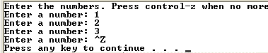
Reading Data until End of File (EOF)
In the same way, when using object input stream, we can check the end of the file (i.e. the end of the data).

Slide 17
Case Study 1
Problem:
To input numbers from a file named ‘numbers.txt’ until the end of the file and display them.
Note:
We need to create the file ‘numbers.txt’ before we can run this program. Otherwise we will get an error.

Slide 18
Case Study 1
The numbers can be written in the file one number per line:
Or several numbers per line:
23 96 77 45 83
23 96 77 45 83

Slide 19
Case Study 1 – Complete Program
#include <iostream>
#include <fstream>
using namespace std;
int main(void)
{
int number;
ifstream inFile("numbers.txt");
if (!inFile)
cout << "Error opening file\n";
else

Slide 20
Case Study 1 – Complete Program
{
cout << "The numbers from the file are:\n";
inFile >> number;
while (inFile)
{
cout << number << endl;
inFile >> number;
}
inFile.close();
}
return 0;
}

Slide 21
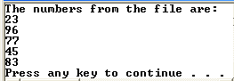
Case Study 1 – Complete Program

Slide 22
Reading String with Spaces from a File
To read a string with spaces from the file, we use function getline which is similar to function gets.
Example: Suppose we have a array of characters:
char str[80];
Example: To read a string from the keyboard:
cin.get(str, 80);
Example: To read a string from the file:
inFile.getline(str, 80);
Reads maximum 79 characters

Slide 23
Case Study 2
Problem:
To read movie titles from a file called ‘movies.txt’ and display the titles on the screen as a numbered list.
Design the solution:
Sample input file Sample screen output
Ice Age 4: Continental Drift 1. Ice Age 4: Continental Drift
The Dark Night Rises 2. The Dark Night Rises
The Amazing Spider-Man 3. The Amazing Spider-Man

Slide 24
Case Study 2 - Complete Program
#include <iostream>
#include <fstream>
using namespace std;
int main(void)
{
char movie[50];
int count;
ifstream inFile("movies.txt");
if (!inFile)
cout << "Error opening file\n";
else

Slide 25
Case Study 2 - Complete Program
{
count = 1;
inFile.getline(movie, 50);
while (inFile)
{
cout << count << ". " << movie
<< endl;
count++;
inFile.getline(movie, 50);
}
inFile.close();
}
return 0;
}

Slide 26
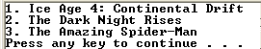
Case Study 2 - Complete Program

Slide 27
Writing Data to a File
To write data to the file, we use object output stream which is similar to cout.
Example: To display an integer on the screen:
cout << "Result = ", << res << endl;
Example: To write an integer to the file:
outFile << "Result = ", << res << endl;

Slide 28
Case Study 3
Problem:
Write a program to compute the pay for a set of employees and print a report showing the pay for each employee and also the total pay. The input data is stored in a file.
Design the solution
We read the data from one file: paydata.txt.
We write the report to another file: payreport.txt

Slide 29
Case Study 3
The pay data in the input file is written as follows:
<emp-id> <pay-rate> <hours-worked>
Example:
1001 50.00 45 1002 60.00 40 1003 55.00 42 . . .

Slide 30
Case Study 3
The pay report is printed with the following heading:
Emp ID Pay
A sample report is as follows:
Emp ID Pay
1001 2250.00
1002 2400.00
. . .
Total 15400.00

Slide 31
Case Study 3 - Complete Program
#include <iostream>
#include <iomanip>
#include <fstream>
#include <cstdlib>
using namespace std;
int main(void)
{
int id;
int hours_worked;
double pay_rate;
double pay;
double total_pay;

Slide 32
Case Study 3 - Complete Program
ifstream inFile("paydata.txt");
if (!inFile)
{
cout << "Error opening input file\n";
exit(100);
}
ofstream outFile("payreport.txt");
if (!outFile)
{
cout << "Error opening output file\n";
exit(100);
}
total_pay = 0.0;
outFile << "Emp ID\t Pay\n";

Slide 33
Case Study 3 - Complete Program
inFile >> id;
while (inFile)
{
inFile >> pay_rate >> hours_worked;
pay = pay_rate * hours_worked;
outFile << left << setw(4) << id << "\t"
<< right << setw(8) << fixed
<< setprecision(2) << pay
<< endl;
total_pay += pay;
inFile >> id;
}
outFile << "Total\t" << right << setw(8)
<< fixed << setprecision(2)
<< total_pay;

Slide 34
Case Study 3 - Complete Program
inFile.close();
outFile.close();
return 0;
}

Slide 35
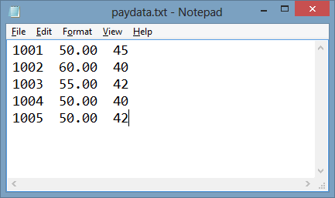
Case Study 3 - Complete Program

Slide 36
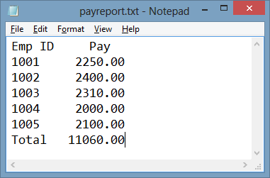
Case Study 3 - Complete Program

